Slide 1

Marketing Campaign Analysis
Portuguese Bank Marketing Dataset
By: Zion Yitbarek and Marhaba Tursunali

Slide 2
Introduction
Problem
Solution
Develop a effective telemarketing strategy to sell long term deposits.
Success rate is only 11%
Re-prioritize the call list
Identify customers likely to subscribe based on given data

Slide 3
Tools and methods used
Tools | Methods
Pandas Library Numpy Matplotlib / Seaborn Scikit-learn (sklearn) Graphviz Imbalanced-learn | Naive Bayes Classification Algorithm Decision Tree Classification Algorithm

Slide 4
Team Distribution
Marhaba
Zion
Data Prep
(normalizing the skewed data, chi square test and dropped low informative attributes)
Data Analysis on the classification algorithms (naive and decision tree)
Addressed the class imbalance using oversampling
Data Prep
(mean,median,mode, created heatmap for feature selection)
Data Analysis on the classification algorithms (naive and decision tree)
Notes:
Marhaba
Data Prep
(normalizing the skewed data, chi square test and eliminating features
Data Analysis on the classification algorithms (naive and decision tree)
Addressed the class imbalance using oversampling
Zion
Data Prep
(mean,median,mode, created heatmap for feature selection)
Data Analysis on the classification algorithms (naive and decision tree)

Slide 5
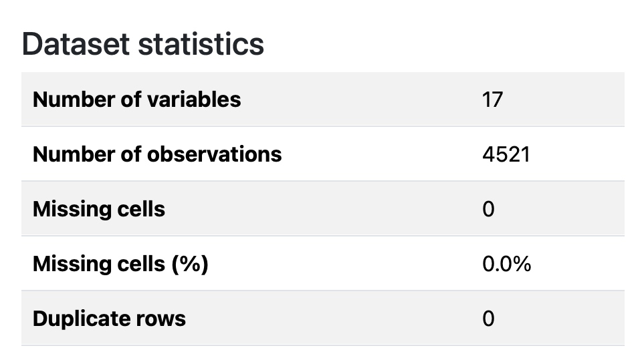
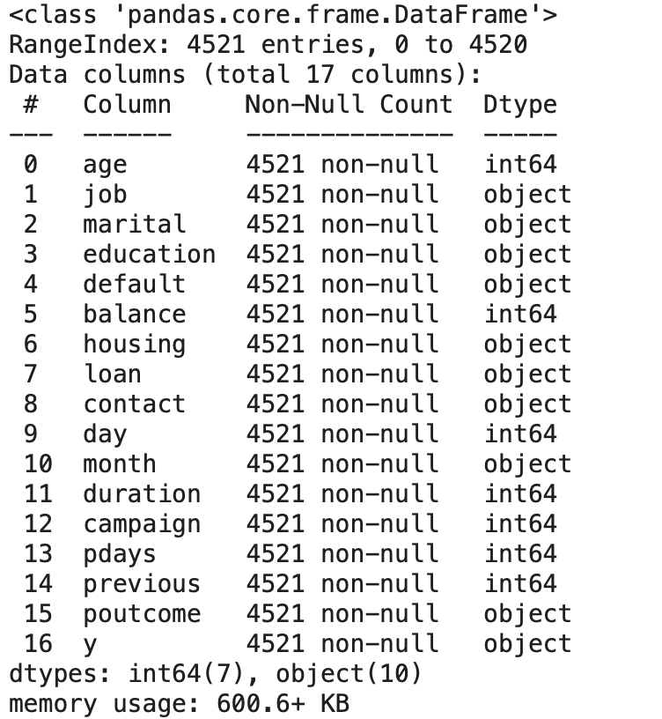
Data Prep
Unknown Variable Summary
Column Name | Unknown Count | Percent of Column (%)
poutcome | 3705 | 81.95
contact | 1324 | 29.29
education | 187 | 4.14
job | 38 | 0.84
Notes:
Data Preparation: (zion)
Our data had a total of 17 attributes including our class attribute which was (y).
There was a total of 4521 number of observations:
There were no missing cells or duplicate rows.
However, there were unknown entries in outcome, contact, education, and job.

Slide 6
Attribute types
Numerical | Nominal | Ordinal
age: Quantitative (continuous) balance: Quantitative (can be continuous) day: Quantitative (discrete) duration: Quantitative (continuous) campaign: Quantitative (discrete count of contacts during campaign) pdays: Quantitative (number of days since last contact) previous: Quantitative (discrete count of previous contacts) | job: Nominal marital: Nominal default: Nominal housing: Nominal loan: Nominal contact: Nominal month: Nominal poutcome: Nominal y (target variable): Nominal (yes/no) | education: Ordinal (likely ordered as: unknown<primary < secondary < tertiary )
Notes:
Attribute Types(Marhaba)
There are three types of attributes: Numerical, Nominal and Ordinal
There were total of 7 attributes that were Numerical, which were age, balance, day, duration, campaign, pdays, previous
There were a total of 9 attributes that were Nominal: job, marital, default, housing, loan, contact, month, outcome, y (target variable)
There was one we identified as Ordinal: education ( ordered as unknown < primary < secondary < tertiary)

Slide 7
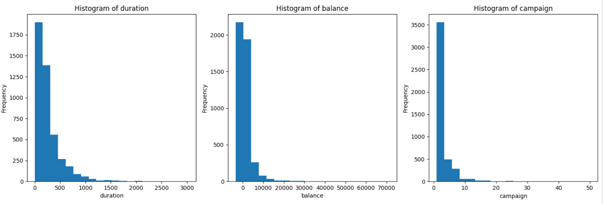
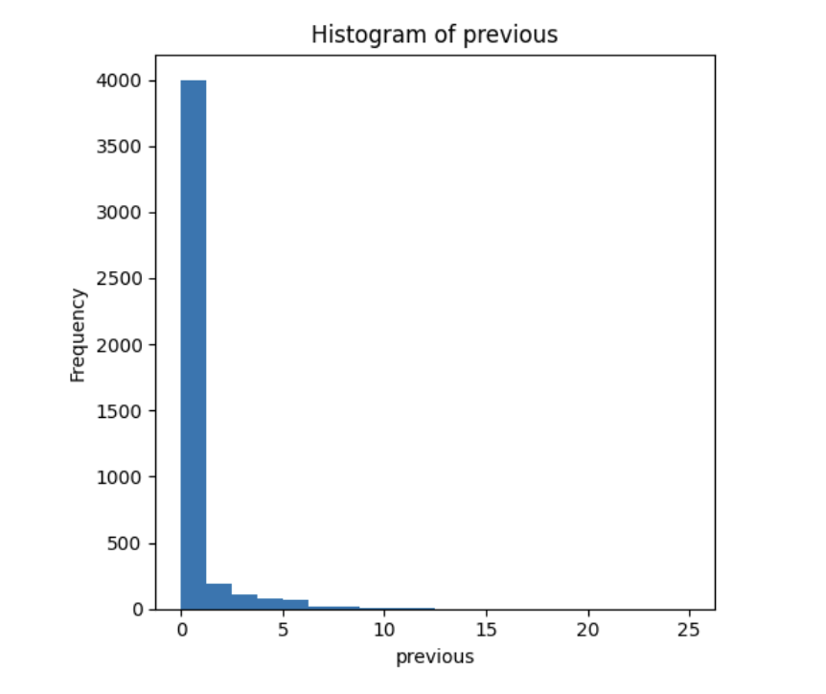
Find Max, Min, Mean and Standard Deviation
 | mean | median | std | min | max
age | 41.17009511170100 | 39.0 | 10.576210958711300 | 19.0 | 87.0
balance | 1422.6578190665800 | 444.0 | 3009.638142467340 | -3313.0 | 71188.0
day | 15.915284229152800 | 16.0 | 8.24766732722993 | 1.0 | 31.0
duration | 263.96129174961300 | 185.0 | 259.85663262468200 | 4.0 | 3025.0
campaign | 2.793629727936300 | 2.0 | 3.109806660188580 | 1.0 | 50.0
pdays | 39.766644547666400 | -1.0 | 100.12112444301700 | -1.0 | 871.0
previous | 0.5425790754257910 | 0.0 | 1.693562350607120 | 0.0 | 25.0
Notes:
Find the Max, Min, Mean and Standard Deviation (zion)
After finding the Max, Min, Mean and Standard Deviation of our numerical attributes, we used histograms to see the distribution of the data . As you can see from the graph all were skewed to the right with the majority of the data being within the 0 range.

Slide 8
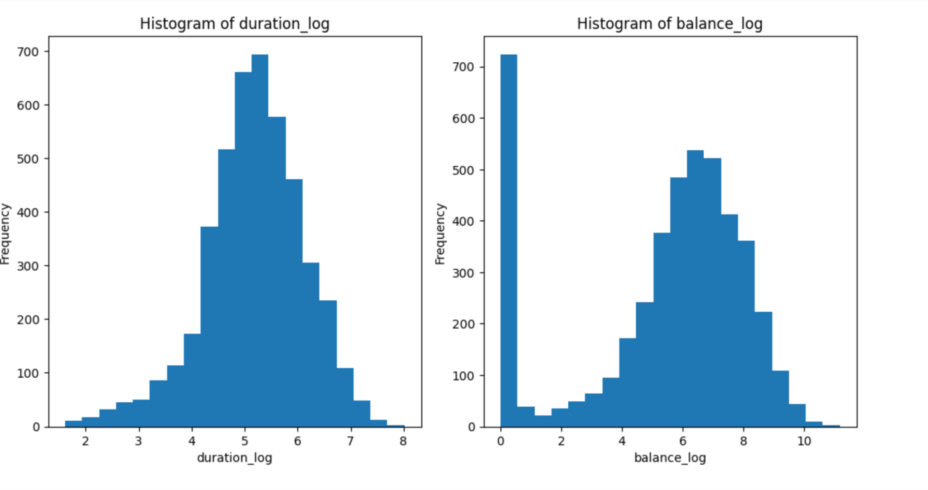
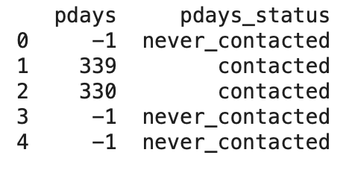
Transformed Attributes
Pdays Turned from numerical to categorical
2. Balance and Duration Normalized the skewed data
Notes:
Transform Attributes (Marhaba)
In order to address this, we normalized the data using log1 which made the data evenly distributed. We did this so we can improve model performance and ensure fair treatment of features
We also transformed the pday column from numerical to categorical. This column looked at the number of days that passed after the client was last contacted from the previous campaign. In order to simplify and not have the numbers misrepresented by the models we categorized it.

Slide 9
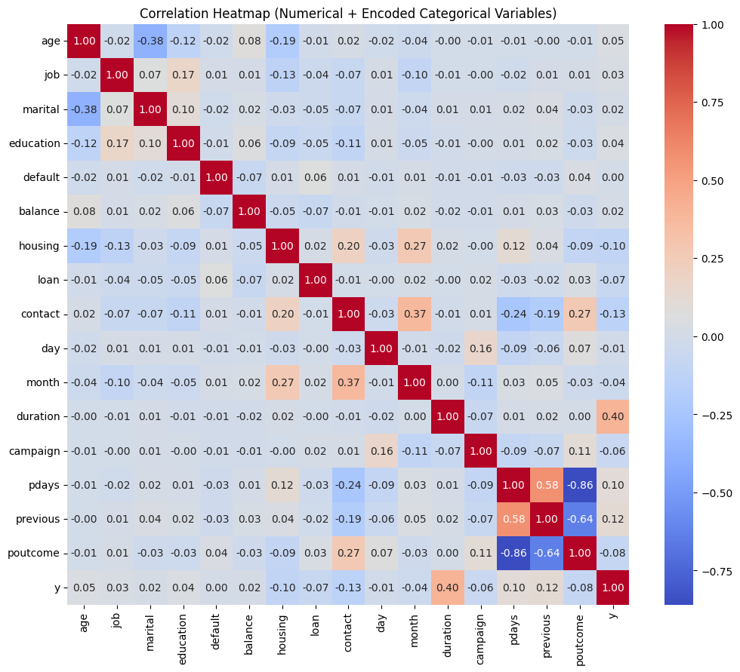
Which attributes seem to be correlated?
Notes:
Heat Map (Zion)
To showcase correlation between the attributes, we decided to go with a heatmap.
The attributes that seem to have a higher correlation with our class attribute, y, is Pdays, campaign, duration, housing, and age.
Day had the lowest correlation to y and which meant there was no strong signal tied to specific days, so we determined “day” column could potentially be dropped.

Slide 10
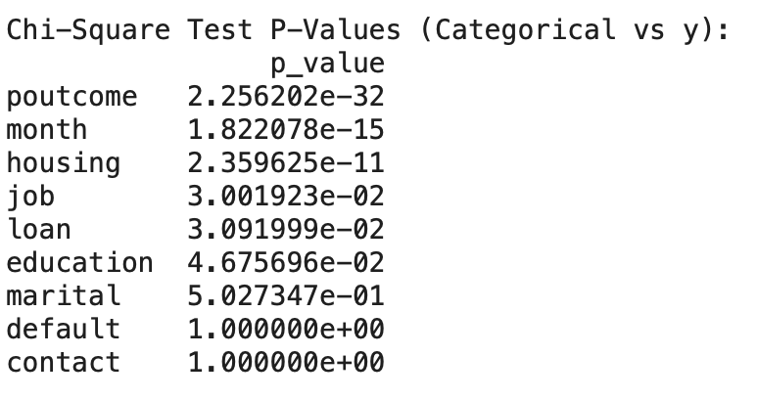
Chi-Square Test
Notes:
Chi Square Test: (Marhaba)
We used the Chi Square test to help us identify the most relevant categorical features .
From this test we see Poutcome, month, housing, job, loan and education all have strong association with our class attribute.
However, marital, default and contact were not significantly linked to (y) so they could be potentially dropped.
Before we dropped these columns, we further analyzed
For default: we found 98% of entries were unknown and since there was little variance in the data we decided could be dropped
For contact: we found contact had only 3 types of entries (cellular, telephone and unknown- which made up 29% of the data). We assumed cellular and telephone can also be used interchangeably; there was little value in this column and dropped from our model.
Marital- we decided to keep and test to see if keeping gave better results.

Slide 11
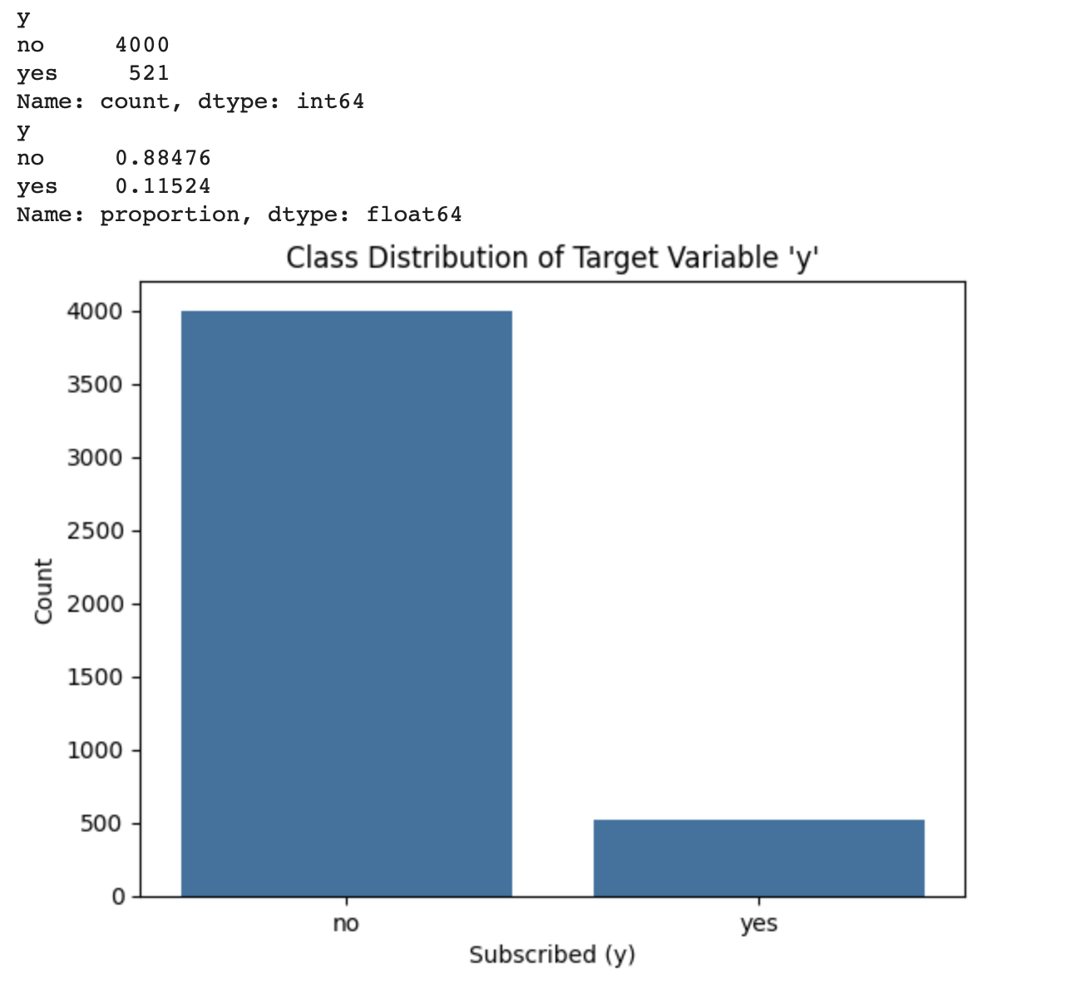
Class Distribution
Notes:
Class Distribution(Zion)
Lastly, we found that our class attribute y was highly imbalanced with 89% of the data being a no and only 11% being a yes. It was important when we ran our models, we also addressed this imbalance.

Slide 12
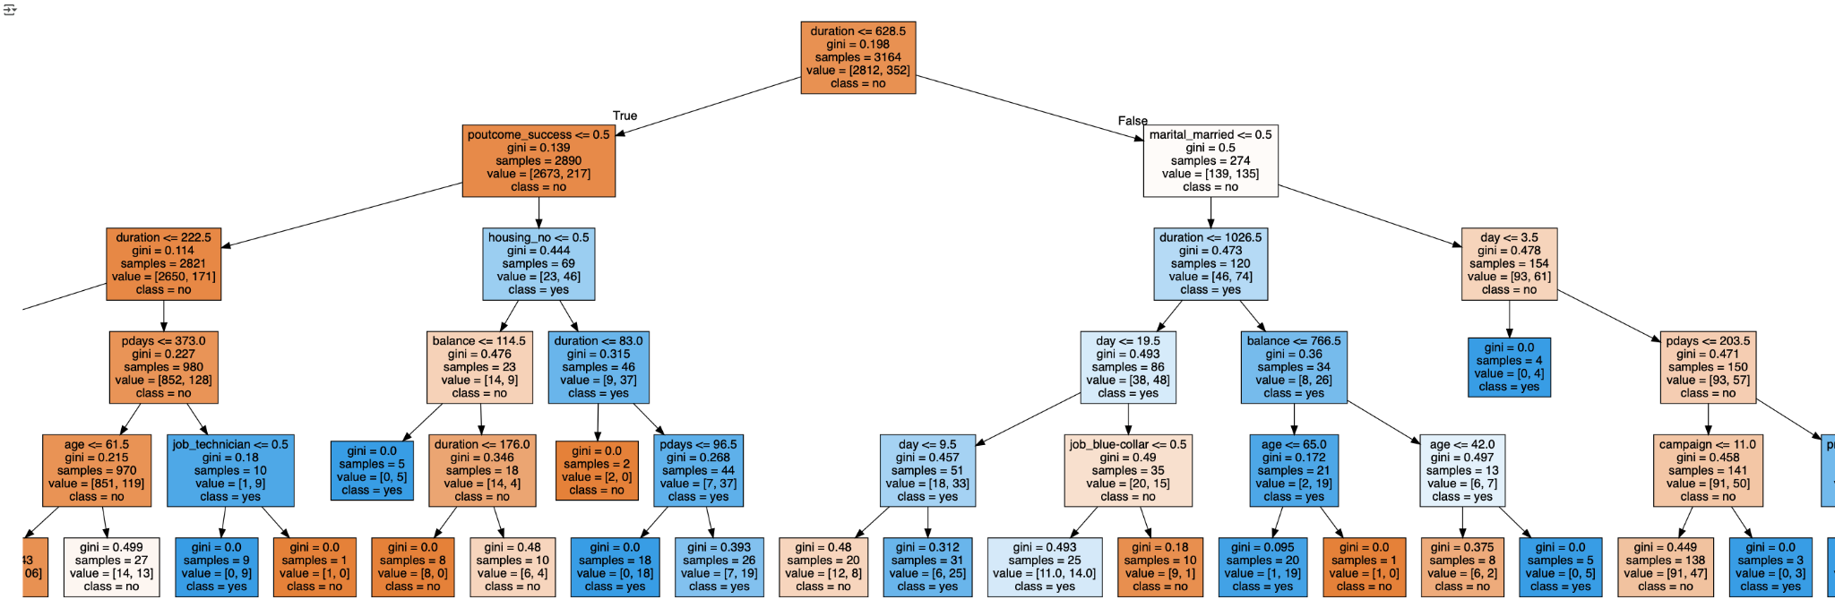
Predictive Modeling- Decision Tree Evaluation (Baseline)
Notes:
Predictive Modeling (Decision Tree Baseline) (Marhaba)
We first ran our predictive model on all the features so we can see if our selected features improved the models performance. For this, we decided to use the train-test split method
This one is the decision tree, we used depth of 5. From this visualization we can see that duration is our root node and the most informative split.
The remaining features being marital, job, poutcome, month and pdays.

Slide 13
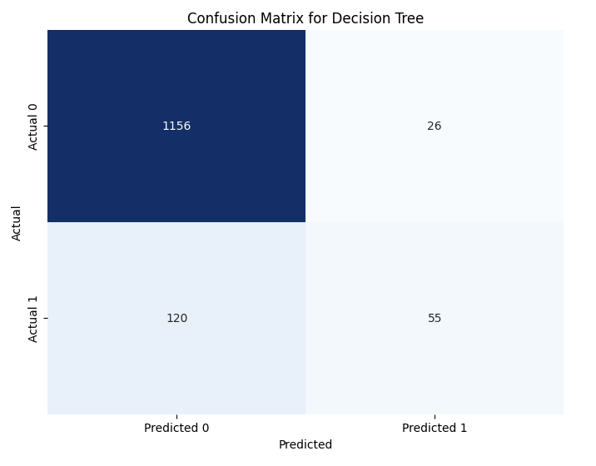
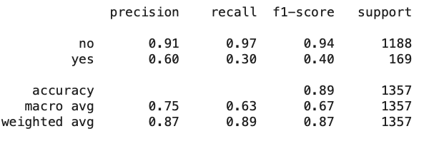
Cont - Decision Tree Confusion Matrix
Notes:
In order to see the models performance we looked at key metrics in the classification report:
This model had overall accuracy of 89% which is pretty high, its precision for no was also very high at 91. However for yes, it was only 60.
From the confusion matrix, we can see that the model favours ‘no’ because it predicted 120 clients as no when it was a yes(false negative). From this, we can takeaway, the model struggles to predict yes, as our recall and f1 score is only 0.30 and 0.40.

Slide 14
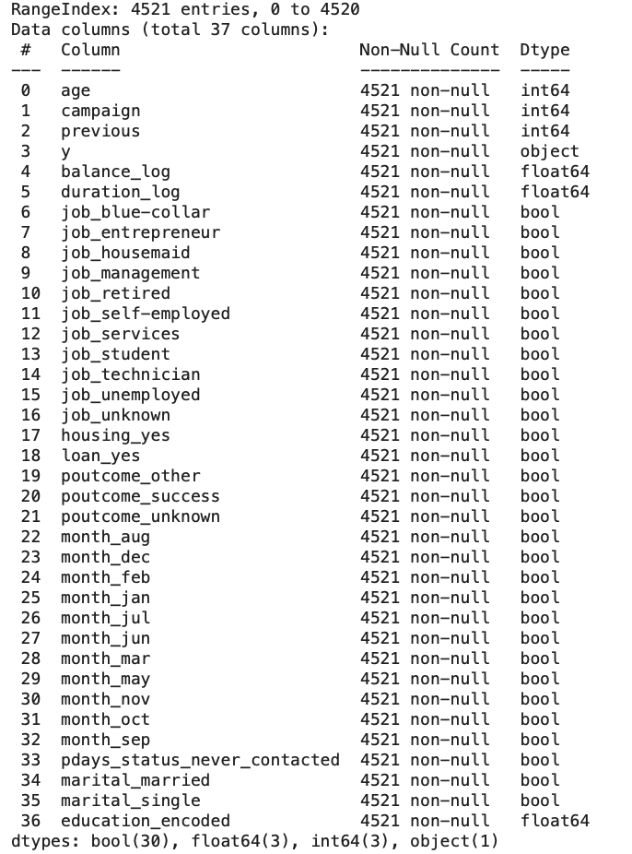
Selected Features
Notes:
Selected Features (zion)
The image on the right hand side showcases our selected features
The selected features include age, campaign, previous, balance, duration,job, housing, loan,poutcome, month pdays and marital.
Contact, default and day were removed to reduce noise in our data and remove predictors that have limited influence.
We also normalized balance and duration, encoded education and categorized pday
We normalized balance and duration as the variables were highly skewed- by doing this, we introduce stability in the data set
We encoded education ( which is a categorical variable) in order to ensure compatibility with the algorithm as well as maintaining the integrity of existing ordinal relationships.
We categorized pday in order to simplify it and turning it into a significant category
By doing this, we would be able to improve model accuracy and also its interpretability

Slide 15
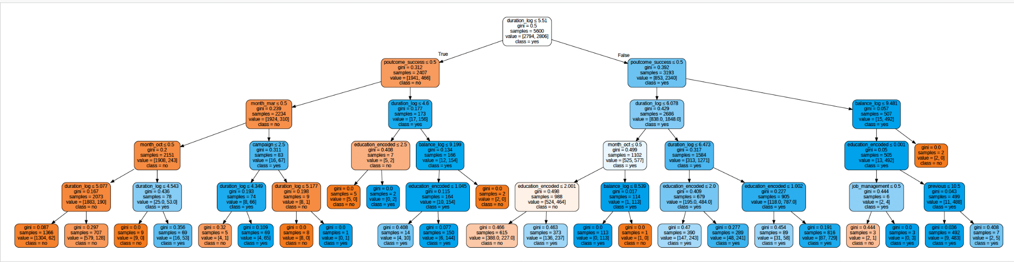
Predictive Modeling- Decision Tree Evaluation (selected)
Notes:
Predictive Modeling (Decision Tree selected) (Marhaba)
We ran the model twice, one with just the selected features and the second time we addressed the class imbalance by using Synthetic Minority Over-sampling Technique.
Basically oversampling the minority class so we could have a more balanced and accurate results.
This decision tree is on selected features and addressing class imbalance. Here we see duration is still the root node and the most important features. The remaining is poutcome, education and month

Slide 16
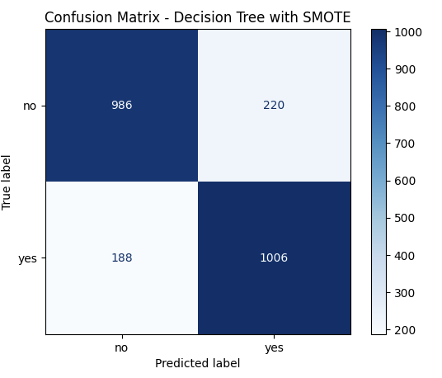
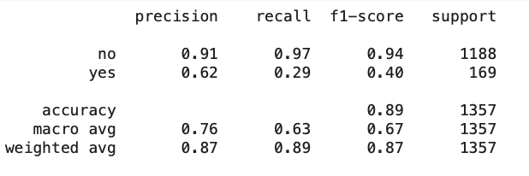
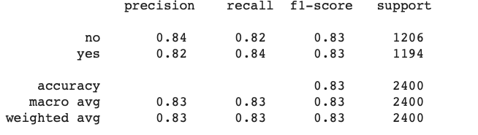
Cont - Decision Tree Confusion Matrix
Selected Features
SMOTE (Synthetic Minority Over-sampling Technique)
Notes:
When we looked at performance, we looked at the model’s performance on selected features, as you can see there was not a lot of difference. Accuracy was still 89% but precision and ability to predict yes was still very low at 0.40
So we used oversampling and ran the model again. This significantly improved the models ability to predict yes, although accuracy was slightly reduced overall, it provided a more balanced model performance.

Slide 17
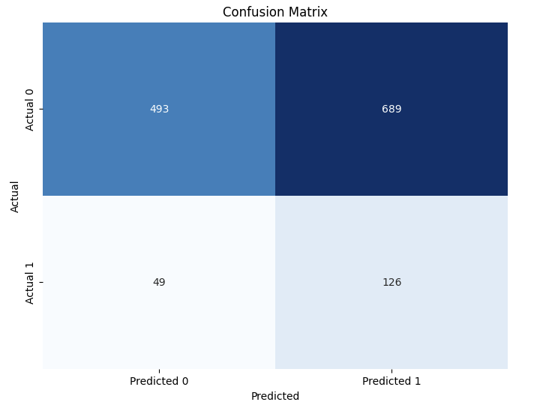
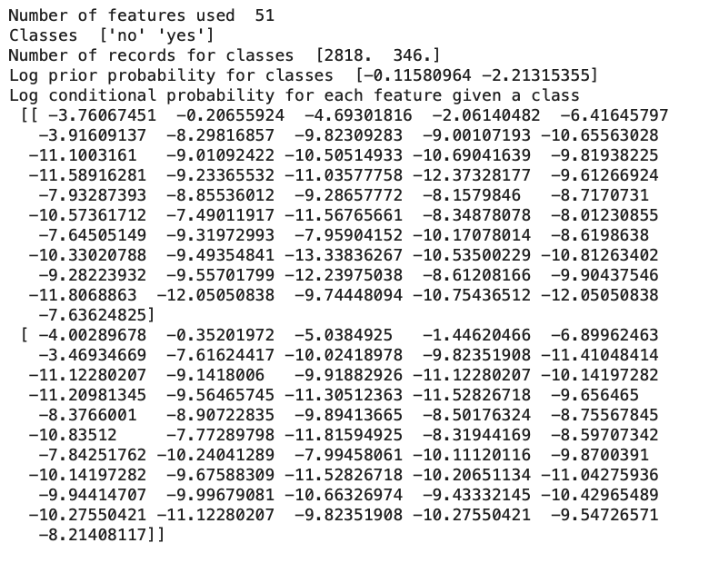
Predictive Modeling- Naives Bayes
Baseline
Notes:
We did the same thing with naive Bayes. We ran the model on all our attributes and from this confusion matrix you can see the model predicted over 689 as yes when it should of been a no so a high false positive. Similarly, this model also struggled to predict yes.
The decision tree underpredicted “yes” while the naives bayes overpredicted “yes”

Slide 18
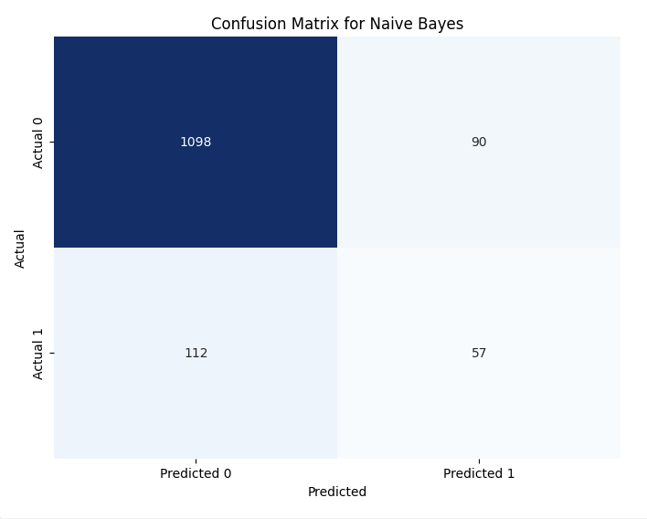
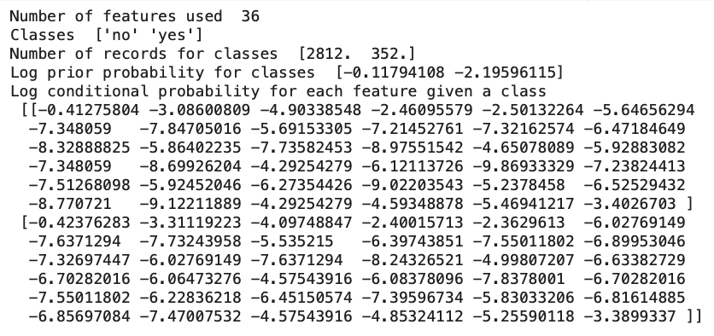
Predictive Modeling- Naives Bayes
Selected
Notes:
When we ran the model on our selected features, we were able to significantly reduce the false positives from 689 to only 90 and increased precision.

Slide 19
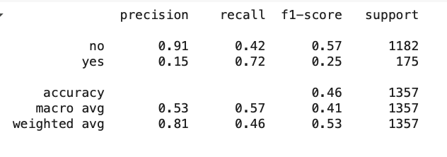
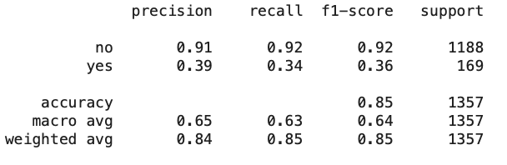
Predictive Modeling- Naives Bayes
Baseline (all attributes)
Selected Attributes
Notes:
The overall accuracy went up from only 0.46 to 0.85.
We also able to increased the models precision for yes from 0.15 to 0.39 with our selected features.

Slide 20
Results and Comparison
Model | Accuracy | Precision | Recall
Baseline Decision Tree | 0.89 | 0.91 no / 0.60 yes | 0.97 no / 0.33 yes
Baseline Naïve Bayes | 0.46 | 0.91 no / 0.15 yes | 0.42 no / 0.72 yes
Decision Tree on Selected Features (SMOTE Oversampling) | 0.83 | 0.84 no / 0.82 yes | 0.82 no / 0.84 yes
Naïve Bayes on Selected Features | 0.85 | 0.91 no / 0.39 yes | 0.92 no / 0.34 yes
Notes:
From testing all these models through different methods, we found that the decision tree using the selected features with the method of oversampling to address class imbalance significantly outperformed all the other models, it was also the one that was the most balanced. So we would recommend the company to use this model to predict future clientele’s likelihood to say yes.

Slide 21
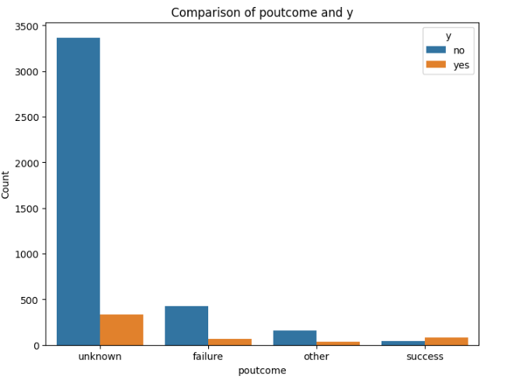
Major Findings
Poutcome-The outcome of previous campaign
If previous campaign was a success, higher chance the client will subscribe to new product

Slide 22
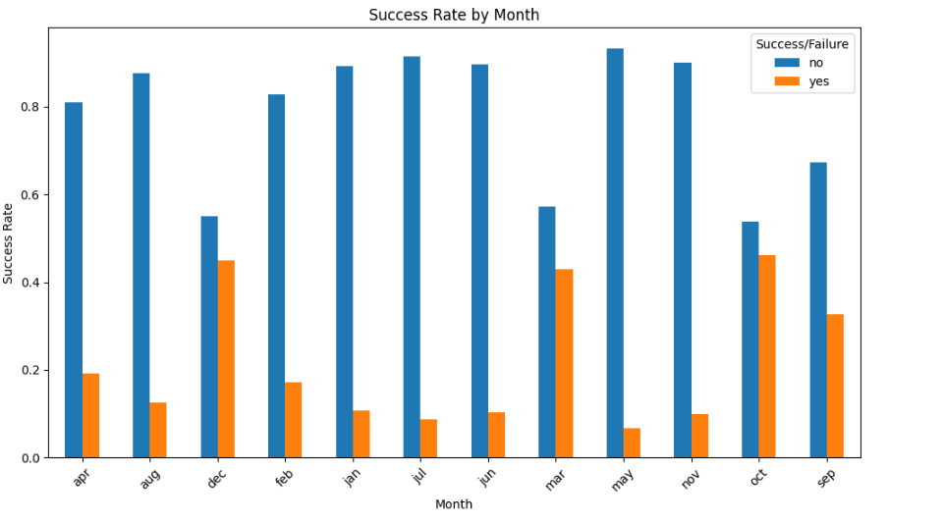
Major Findings-Cont
Higher Success Rate in the following months:
December
September
October
March

Slide 23
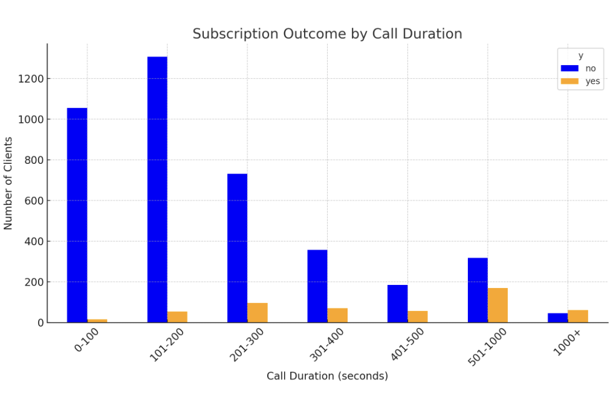
Major Findings-Cont
Longer the call, the higher the chance they will subscribe.
Duration is also highly correlated with our class attribute (subscribe=yes, not subscribe=no)
It is also the most important split in our decision tree

Slide 24
Recommendation/Solution
Re-prioritization the call list by:
Call customers who had a successful outcome in the previous campaign as they are likely to subscribe
Increase the number of calls in December, October, September and March
Train agents to create engaging calls with potential clients- invest conversation quality
Notes:
To help the company increase the number of “yes” responses in the y column (which indicates a successful marketing campaign sign-up), we can analyze which features are strongly associated with a “yes” outcome.
From our analysis, we found the following results:
P-outcome to y
Months to y
Contact to y
Duration to y

Slide 25
THANK YOU

